Slide 1
Care International &
Her Justice
413

Slide 2

Care International
Mission Statement
Care works around the globe to save lives, defeat poverty and achieve social justice.
Care’s Focus: “We put women and girls in the center because we know that we cannot overcome poverty until all people have equal rights and opportunities.

Slide 3
History
-The first care package arrived in Le Havre, France, in May 1946.
Known then as the Cooperative for American Remittances to Europe. It consisted of 22 American charities of civic, religious, cooperative and labour backgrounds.
Care took possession of 2.8 million USA army surplus packages in 1946. Each containing enough food to feed ten people for one day.
The packages contained butter, dried milk, canned meat, and sometimes chocolate and chewing gum.
Seven decades later Care evolved to become one of the largest poverty-fighting organizations in the world providing relief to people hit by disasters and emergencies, and contributing to economic empowerment that strengthens livelihoods over the long term, starting with women and girls.
After Europe Care got involved with Japan, and then the Philippines, Korea, India and Pakistan. By early 1950’s operations were established in a number of Latin American countries followed by Africa in the early 1960’s (during this time care also started providing medical services).
In the early 1980’s Care’s longer term development programs increasingly began focusing on ways to improve the status of women, and encourage greater participation.

Slide 4
Her Justice
Mission Statement
Her Justice stands with women living in poverty in New York City by recruiting and mentoring volunteer lawyers to provide free legal help to address individual and systemic barriers.
Her Justice pairs thousands of well-trained and resourced, pro bono attorneys with women who have legal needs in the areas of family, matrimonial and immigration law. They break down barriers that are built into our civil justice system, barriers that reinforce and exacerbate gender, racial and economic imbalances.

Slide 5
History
Her Justice launched in 1993. Cathy Douglass first came up with the idea for the organization while serving on the board of a domestic violence nonprofit that was launching a legal program. They offered shelter and advocacy for abused women, but decided to bring a lawyer on board. Cathy saw that they could serve more clients and suggested that they start a pro bono project she knew a lot of lawyers and firms that would like to help. The staff attorney’s did not have time to do anything else and thats when Cathy knew she no longer wanted to work for a big firm. Cathy got a partnership at Willkie and received $75,000 in funding thats when Network for Women Services became incorporated and Cathy started her new journey.

Slide 6
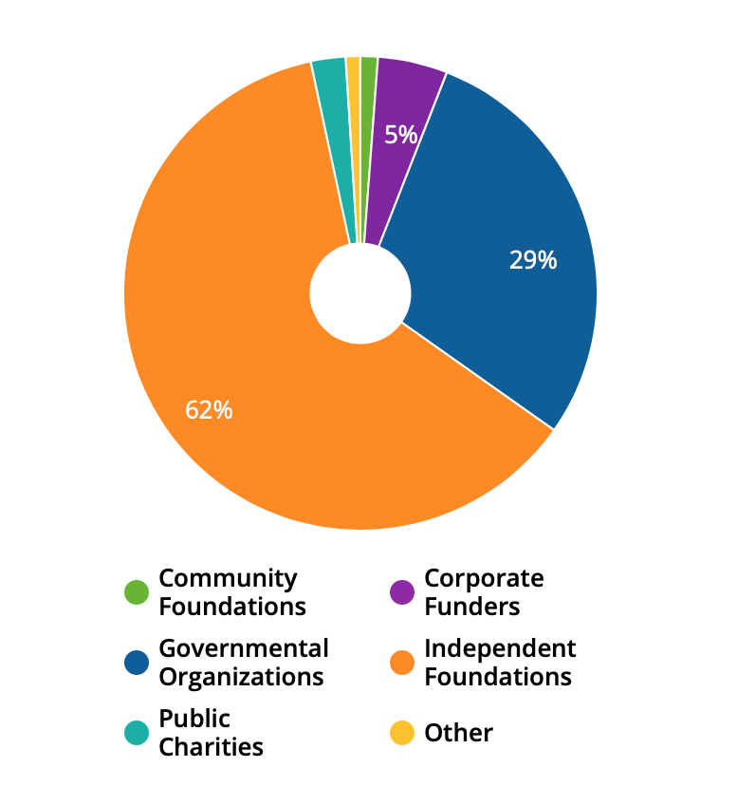
Finances
Care Grant Amounts:
62% is Independent Foundations $643,072,945
29% is Governmental Organizations $299,757,796
5% is Corporate Funders $49,640,797
2% is Public Charities $24,520,171
They received 6,099 grants from 1,206 grantmakers totaling $1,030,300,247

Slide 7
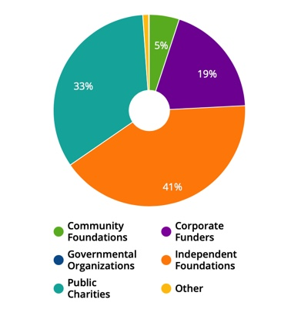
Finances
Her Justice Grant Amounts:
41% is Corporate Foundations $1,152,385
33% is Public Charities $937,453
19% is Corporate Funders $536,457
5% is Community Foundations $142,250
They received 236 grants from 81 grant makers totaling $2,771,545

Slide 8
Performance Measure
In 2020, Care and partners helped more than 33.8 million people to support women’s rights to sexual, reproductive and maternal health, indirectly benefiting a further 251.2 million
Care reached 2.6 million women and girls to promote their access to and control of economic resources
In FY20 Care worked in 104 countries around the world, implementing 1,349 poverty-fighting development and humanitarian aid projects and initiatives
Care also reached 433.4 million people indirectly through its advocacy, replication of successful programs, and scale up of innovations
In FY20 Her Justice had
14 lawyers
1,765 volunteer attorneys
served 6,902 women and their children
A total of 63,554 hours donated
Representing $38,636,825 in value
Care International Her Justice

Slide 9
Challenges
Care International / Her Justice
Her Justice
dealing with their immigration policy platform initiatives would be ICE, separating children from their parents, increased fees for immigration petitions, restrictions on fee waivers.
Some hurdles COVID-19 has caused accessing family court has been challenging for clients because the court requires them to appear in person.
At the beginning of the pandemic family court closed except for essential services such as emergency proceeding which were being held virtually which caused challenges for women living in poverty who did not have access to technology
Cases have been proceeding slowly
Care International
Launching a response to COVID-19
A global health crisis would widen the gender gap and reverse decades of progress across women’s health, nutrition, and economic stability.

Slide 10
How COVID-19 affected the organizations activities
Care: Adapted more programs, became better informed especially about gender, became more mobile, partnering more effectively, raising money for people who need it most
Her Justice: Providing more external services, partnering with community base organizations and agencies, live legal helpline,

Slide 11
References
About Her Justice. Her Justice. (2021, April 2). https://herjustice.org/about-her-justice/.
CARE HQ. CARE - GuideStar Profile. (n.d.). https://www.guidestar.org/profile/13-1685039#operations.
Financial Insecurity, Hunger, Mental Health are Top Concerns for Women Worldwide. Care International. (n.d.). https://www.care-international.org/news/press-releases/financial-insecurity-hunger-mental-health-are-top-concerns-for-women-worldwide.
Governance. Care International. (n.d.). https://www.care-international.org/who-we-are-1/governance.
Her Justice Funding . (n.d.). https://fconline-foundationcenter-org.turing.library.northwestern.edu/fdo-recipient/?collection=recipients&activity=result&_new_search=1&quicksearch=&subject_match=match_any&subject_area=&geographic_focus=&population_match=match_any&population_served=&organization_name=&organization_location=&staff=&government_grantmaker=1&support_strategy=&transaction_type=&organization_type=&amount_min=%240&amount_max=%2410%2C000%2C000%2C000&year_min=2003&year_max=2021&keywords=&ein=13-3688519&id=796099&from_search=1.
Her Justice. Her Justice - GuideStar Profile. (n.d.). https://www.guidestar.org/profile/13-3688519#financials.
Meyer , E. (2021, April 20). Legal Obstacles to Women Living in Poverty During the Pandemic: A Conversation with Her Justice. Proskauer For Good. https://www.proskauerforgood.com/2021/04/legal-obstacles-to-women-living-in-poverty-during-the-pandemic-a-conversation-with-her-justice/.
Our Impact. Her Justice. (2021, January 26). https://herjustice.org/about-her-justice/our-impact/.

